Slide 1

B. Tech (Environmental Studies)
AIR POLLUTION
Unit 5
Environmental Pollution
Department: Chemistry
Subject: Environmental Studies (CHM1002)

Slide 2
Definition
Air pollution: presence of one or more contaminants in such quantities and of such durations which tend to be injurious to human, animal or plant life, or property, or which unreasonably interferes with the comfortable enjoyment of life or property or conduct of business.

Slide 3
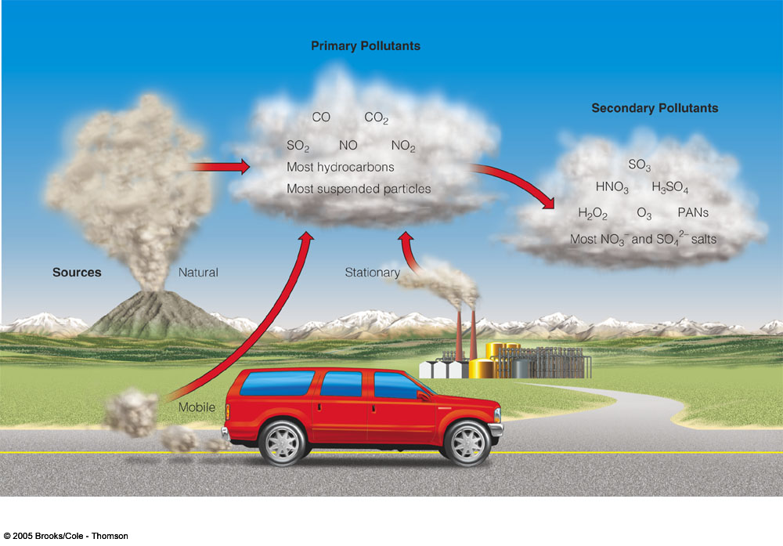
Major Classes of air pollutants
2SO₂ (g) + O₂ (g) + 2H₂O (l) → 2H₂SO₄ (aq)
Primary pollutants
CO₂ (g)+H₂O(l)-→H₂CO₃(aq)
Secondary pollutants
2NO₂(g)+H₂O(l)-→HNO₂(aq)+HNO₃(aq)
Primary air pollutant
Pollutants that are emitted directly from identifiable sources are produced both by natural and anthropogenic events.
Secondary pollutants
Pollutants that are formed by atmospheric chemical combination among the primary pollutants and others

Slide 4
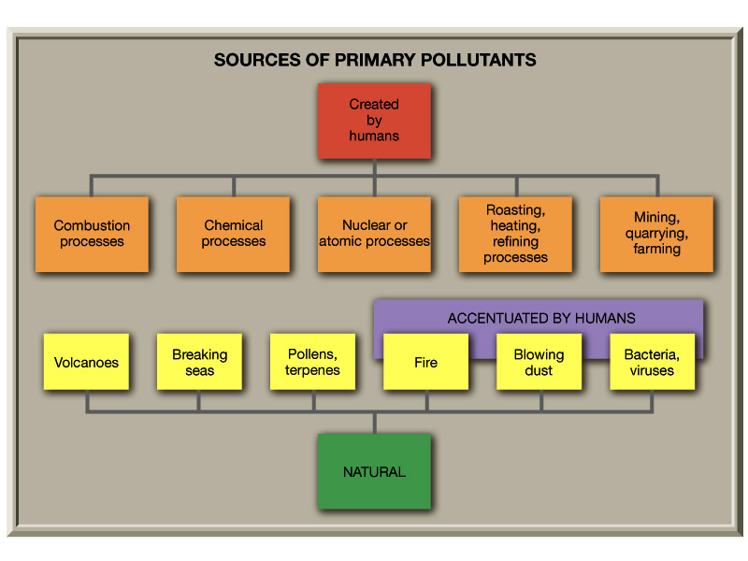
SO₂, NO_{x} , CO, CO₂ and other toxic pollutants

Slide 5
Table 1: Sources, Health and Welfare Effects for Criteria Pollutants.
Pollutant | Description | Sources | Health Effects | Welfare Effects
Carbon Monoxide (CO) | Colorless, odorless gas | Motor vehicle exhaust, indoor sources include kerosene or wood burning stoves. | Headaches, reduced mental alertness, heart attack, cardiovascular diseases, impaired fetal development, death. | Contribute to the formation of smog.
Sulfur Dioxide (SO₂) | Colorless gas that dissolves in water vapor to form acid, and interact with other gases and particles in the air. | Coal-fired power plants, petroleum refineries, manufacture of sulfuric acid and smelting of ores containing sulfur. | Eye irritation, wheezing, chest tightness, shortness of breath, lung damage. | Contribute to the formation of acid rain, visibility impairment, plant and water damage, aesthetic damage.
Nitrogen Dioxide (NO₂) | Reddish brown, highly reactive gas. | Motor vehicles, electric utilities, and other industrial, commercial, and residential sources that burn fuels. | Susceptibility to respiratory infections, irritation of the lung and respiratory symptoms (e.g., cough, chest pain, difficulty breathing). | Contribute to the formation of smog, acid rain, water quality deterioration, global warming, and visibility impairment.
Ozone (O₃) | Gaseous pollutant when it is formed in the troposphere. | Vehicle exhaust and certain other fumes. Formed from other air pollutants in the presence of sunlight. | Eye and throat irritation, coughing, respiratory tract problems, asthma, lung damage. | Plant and ecosystem damage.
Lead (Pb) | Metallic element | Metal refineries, lead smelters, battery manufacturers, iron and steel producers. | Anemia, high blood pressure, brain and kidney damage, neurological disorders, cancer, lowered IQ. | Affects animals and plants, affects aquatic ecosystems.
Particulate Matter (PM) | Very small particles of soot, dust, or other matter, including tiny droplets of liquids. | Diesel engines, power plants, industries, windblown dust, wood stoves. | Eye irritation, asthma, bronchitis, lung damage, cancer, heavy metal poisoning, cardiovascular effects. | Visibility impairment, atmospheric deposition, aesthetic damage.

Slide 6
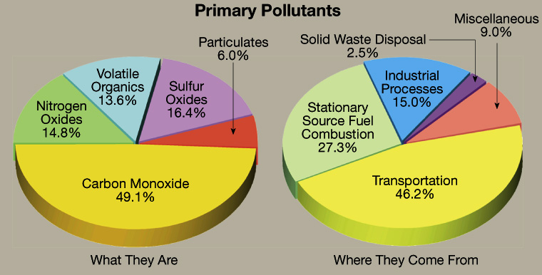
i) Gaseous air pollutant
ii) Particulate mater (Dust)

Slide 7
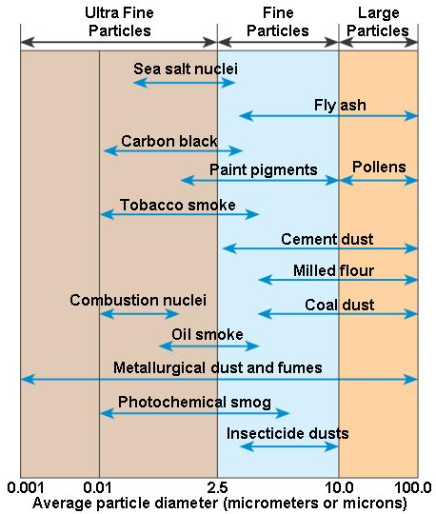
Particulate mater
Besides technical names PM10 and PM2.5, the popular names of particulate
Mist: Aerosol consisting of liquid droplets Sulfuric acid mist
Dust: solid particles produced from larger particles by grinding them down
Smoke: solid particles or a mixture of solid, Cigarette smoke
Fume: Generally means the same as smoke but often applies Zinc/lead fumes specifically to aerosols produced by condensation of hot vapors of metals.
Fog: Aerosol consisting of water droplets

Slide 8
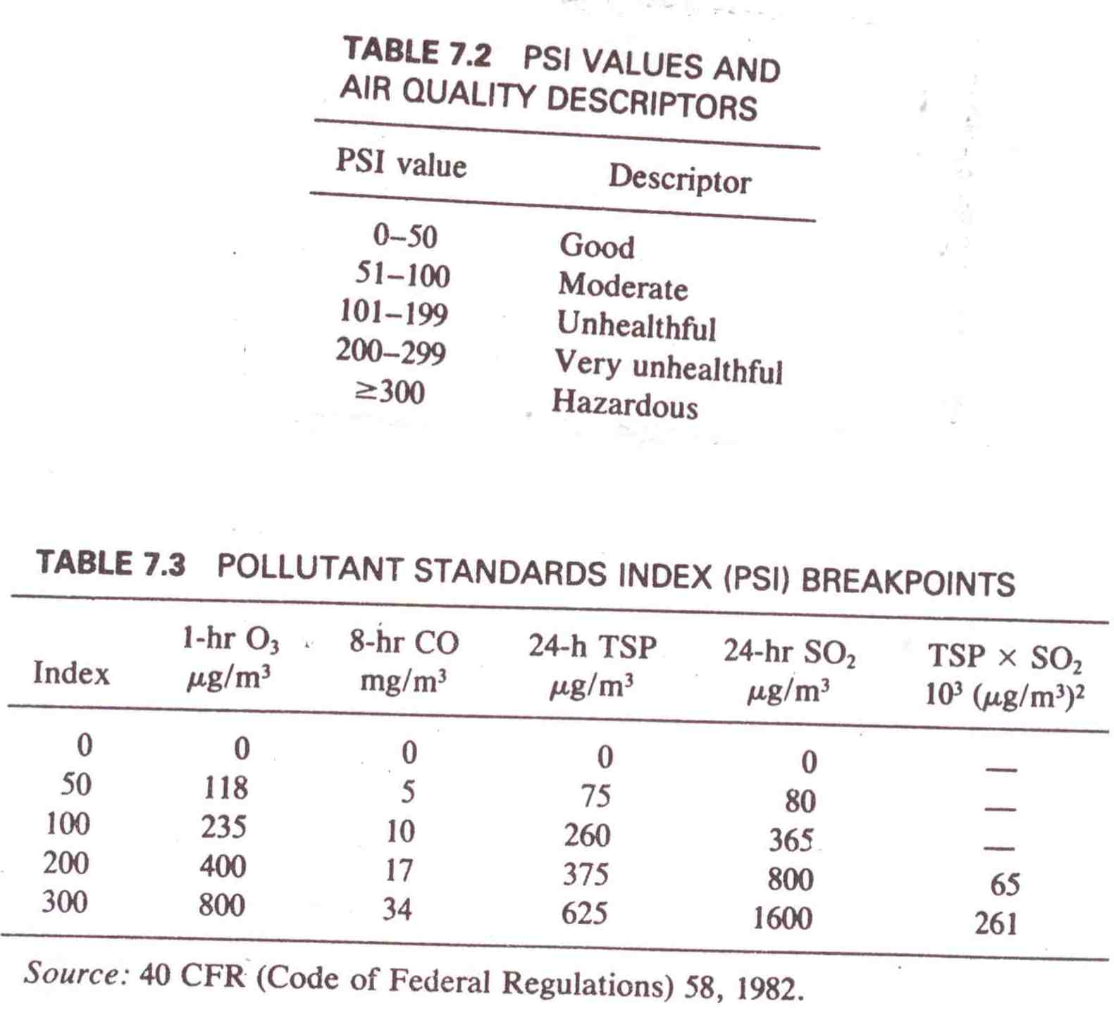
Air Quality Index (AQI) Values

Slide 9
National Ambient Air Quality Standard (NAAQS)-2009
It was notified on 16-11-2009 by government of India. Some of the important air quality parameters are mentioned in the table
Pollutant parameter | unit | Averaging | Concentration in ambient air
 |  |  | Industrial/residential area
Sulfur dioxide | µg/m³ | 24 hourly | 80
Nitrogen dioxide | µg/m³ | 24 hourly | 80
Particulate PM10 | µg/m³ | 24 hourly | 100
Particulate PM2.5 | µg/m³ | 24 hourly | 60
Carbon monoxide | µg/m³ | 8 hourly | 2000
ozone | µg/m³ | 8 hourly | 100

Slide 10
Air pollution control:

Slide 11
Control of Particulate matter
Pollution control methods | Removal mechanism | Particle size removal | efficiency | Design parameters
Gravity settling chamber | Gravity | >50 µ | >50% | -
Cyclone separator | Centrifugal forces and gravity | >5 µ | >85% | -
Bag filter | Interception, impaction and diffusion | < 0.1 µ | >99% | Air to cloth or filtering ratio 0.5 to 5 m/minute
Electrostatic precipitator (ESP) | Electrostatic forces of attraction | < 0.1 µ | >99%

Slide 12
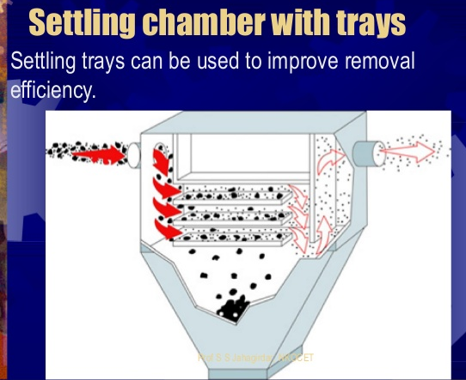
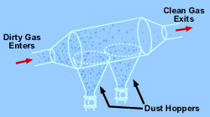
Settling Chambers
Principle: Suddenly increase in flow cross sectional area of the influent dust laden air from a to A at constant flow rate, the horizontal velocity of the particulate matter drop down from V to v when it enter in to the settling chamber (with high cross sectional area) from a pipe (small cross sectional area) thus the horizontal momentum of the Particulate matter floating in the air decreases and the gravitational force over come the horizontal momentum, as a result the particulate matter move down ward due to gravity and settled in the bottom, and clean air exhausted in the out pipe of the settling chamber
Application many tray in settling chamber increases the settling area also reduces the vertical distance
facilitate settling efficiently and quickly
Large particles drop out of the gas and are recollected in hoppers
Figure: Settling chambers

Slide 13
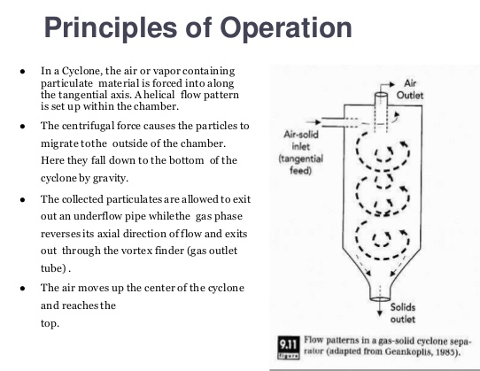
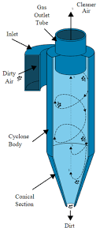
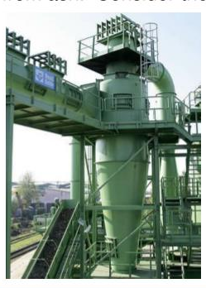
Cyclone Separator

Slide 14
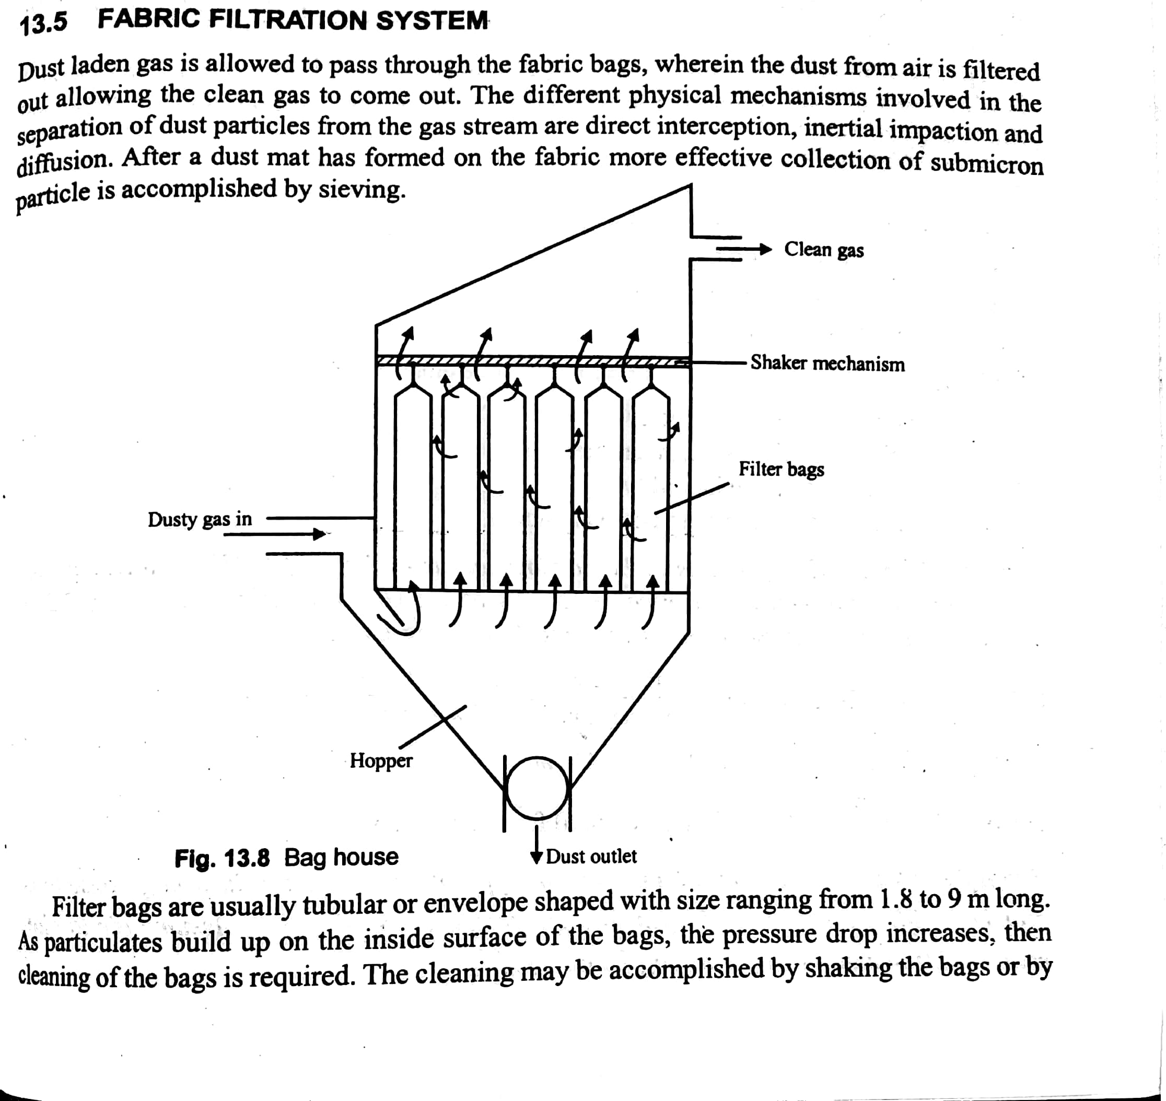
Fabric filters, or baghouses, remove dust from a gas stream by passing the stream through a porous fabric. The fabric filter is efficient at removing fine particles and can exceed efficiencies of 99 percent in most applications.

Slide 15
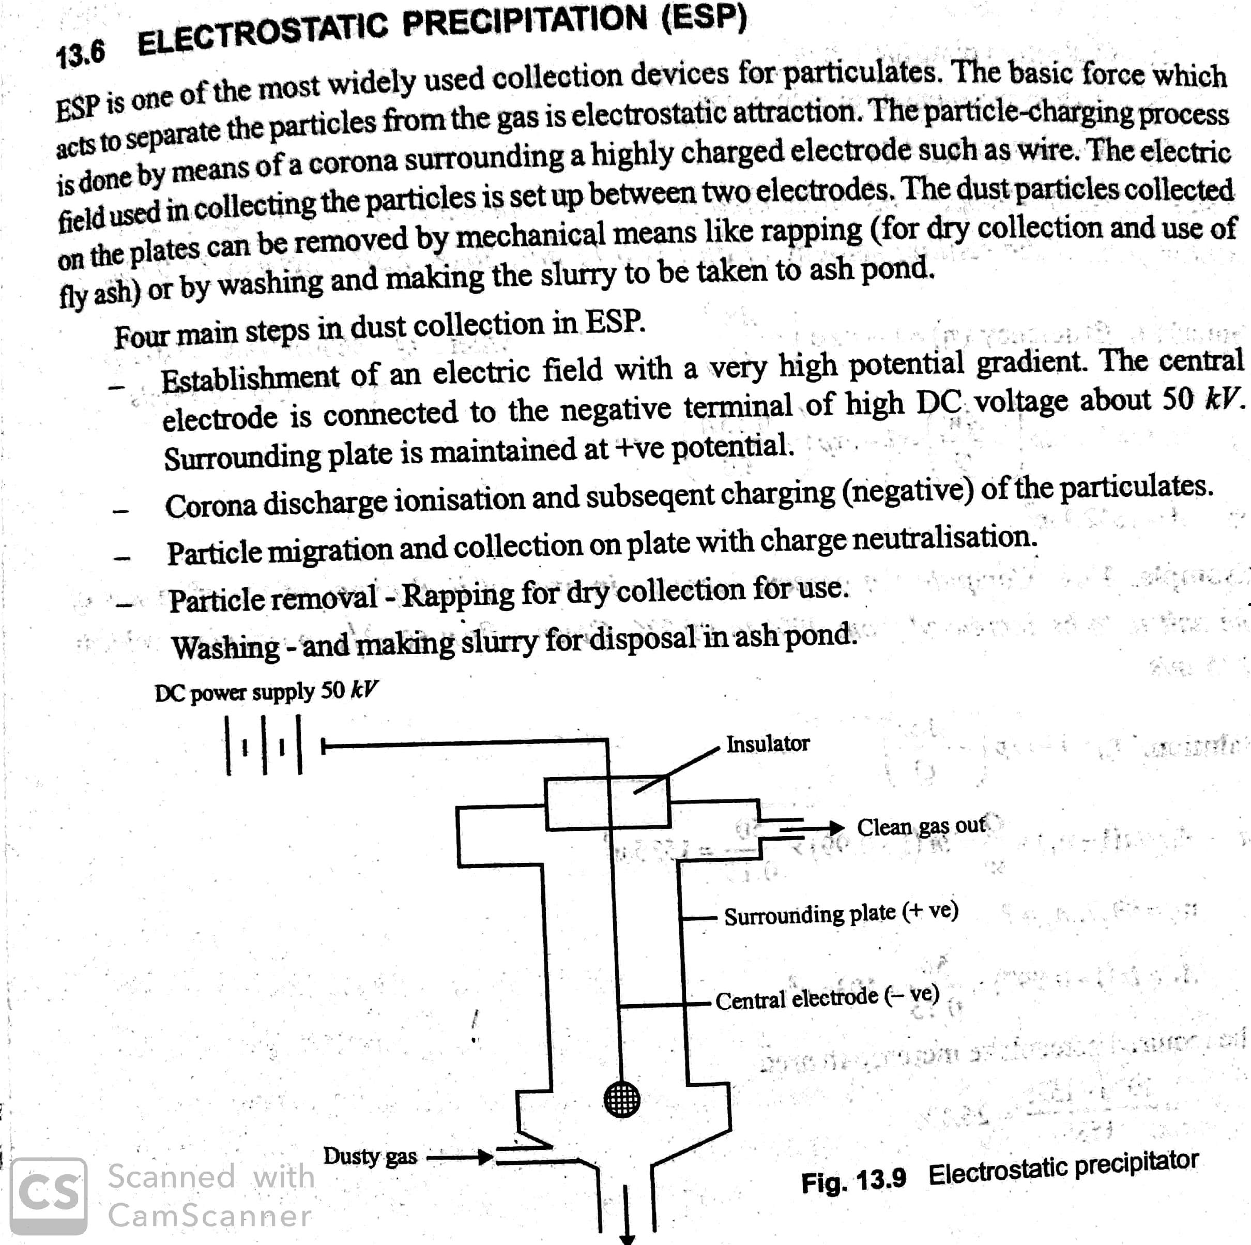
Efficiency of ESP (ƞ) = 1- exp(- Aw/Q)
Ƞ = 0 to 1
A = Collector plate area in m2
w = particulate velocity
Q = Gas flow in m3/sec

Slide 16
Numerical on bag filter
Q- A bag house is to be constructed using bags of 0.25 m diameter and 6 m long. It is to receive 15 m³/s of air. Assuming the filtration rate of 2.2 m/min. Determine the no bags required in the bag house.
Ans:-Total filtration area required= gas flow rate /filtration rate= 15x60 m³/min/2.2 m/min= 409.1 m2
Area of one bag = pi*D*H= 3.14*0.25*6 =4.71 m²
No of bags required in bag house= 409.1/4.71 =86.8 that is 87 bags

Slide 17
Numerical on ESP
Efficiency of ESP (ƞ) = 1- exp(- Aw/Q)
Ƞ = 0 to 1
A = Collector plate area in m²
w = particulate velocity
Q = Gas flow in m³/sec
Compute the plate area of ESP handling a flow of 3600 m³/min. If the particulate velocity is taken as 0.15 m/s, and efficiency of ESP as 99 %
(ƞ) = 1- exp(- Aw/Q)
0.99 = 1- exp (0.15*A/3600/60)
A = Area of plate =1842.1 m²

Slide 18
Control of gaseous pollutants from stationary sources
The most common method for controlling gaseous pollutants is the addition of add-on control devices to recover or destroy a pollutant.
There are four commonly used control technologies for gaseous pollutants:
  Absorption,
  Adsorption,
  Condensation, and
  Incineration (combustion)

Slide 19
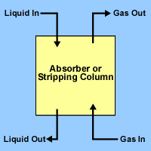
Absorption
Absorption: involves transfer of pollutant from gas stream to liquid stream. Examples are removal of ammonia by water, hydrogen sulphide by sodium hydroxide etc.
The
Absorption is a process in which a gaseous pollutant is dissolved in a liquid.
Absorbers are often referred to as scrubbers,
Typical Packed Column Diagram
In general, absorbers can achieve removal efficiencies grater than 95 percent.
One potential problem with absorption is the generation of waste-water, which converts an air pollution problem to a water pollution

Slide 20
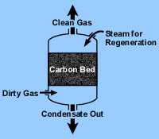
Adsorption
Adsorption involves transfer of pollutant from gas or liquid stream to solid surfaces having desirable surface properties.
The most common industrial adsorbents are;
Activated carbon
Silica gel
Alumina,
because they have enormous surface areas per unit weight.

Slide 21
Incineration
Incineration, also known as combustion, is most used to control the emissions of organic compounds from process industries.
This control technique refers to the rapid oxidation of a substance through the combination of oxygen with a combustible material in the presence of heat.
When combustion is complete, the gaseous stream is converted to carbon dioxide and water vapor.
Equipment used to control waste gases by combustion can be divided in three categories:
  Direct combustion or flaring,
  Thermal incineration and
  Catalytic incineration.
  3T= Temperature, Time, and turbulence

Slide 22
